Slide 1


SAP UI5 & FIORI with OData TRAINING using BAS
Anubhav Oberoy
Day – 8

Slide 2

Agenda – Day 8
What is Resource Model.
Steps to create a Resource Model.
Formatter
How to create a formatter
Base controller
How to create a base controller.

Slide 3
Resource Model
We build software for international audience, we cannot just hardcode every screen element in English, if it requires multi-lingual support, we need to add resource model.
i18n → Internationalization : Make the app available for international usage, which means supporting multiple languages.
There are 2 job roles in the process:
UI5 Consultant
Language Expert KM
?sap-ui-language=hi
Implement the model to provide support for internationalization
Translate the texts to provide support in multiple languages
I18n.properties
TEXTS
Language specific

Slide 4
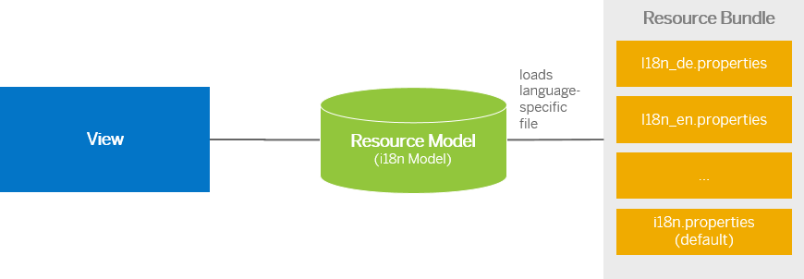
Steps to Create a Resource Model
Create resource bundle which includes label field
Create a folder i18n and inside this folder the file named i18n.properties for default labels.
And i18n_langcode.properties for different languages
Set The model
For more information about i18n you check the link
https://openui5.hana.ondemand.com/1.34.9/docs/guide/831039835e7c4da3a8a0b49567573afe.html
We can change the language of the app by adding ?sap-language=language_code at the end of the URL of the app. Example for Hindi we will write ?sap-language=hi

Slide 5

Hands-on: Resource Model
In this exercise we will see how the language of an app is changed using the i18n file.
We have to create a folder ‘i18n’ in webapps folder and in the folder, we have to add files named ‘i18n.properties’ and one another file named according to the language we want. For example:- for Hindi language the file is named as ‘i18n_hi.properties.
Exercise Code:-
Main.view.xml
Main.controller.js
model.js
i18n.properties
i18n_hi.properties

Slide 6
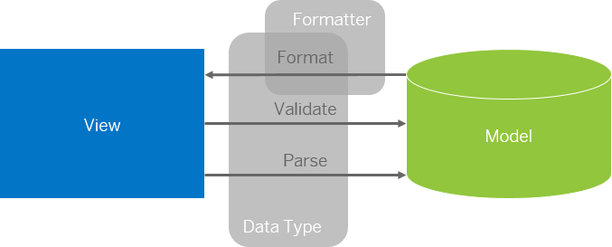
Formatter in SAP UI5
Formatters are used to define the formatting of data on the UI while data types work in both directions: they format the data on the UI and parse and validate user input that is entered.
Formatter is a function; This function gets called JUST Before the binding takes place with the view.
Formatter file is placed in a folder in webapp folder, and the file can be named anything with the .js extension.

Slide 7
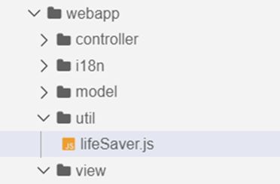
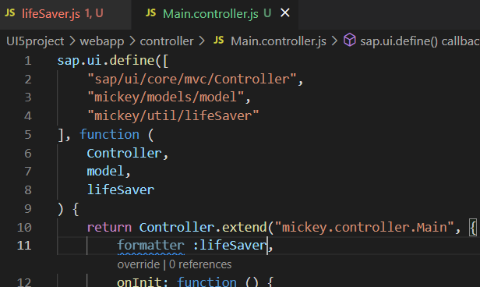
How to create a formatter
To create a formatter first create a utils or util folder inside the webapp folder.
Now create a file lifesaver.js inside the util folder .
Inside the file (lifeSaver.js) create the function(convertUC) for formatting.
After creating this function , inside the controller include it as a dependency and create a global variable at controller level which is accessible in the current view.
Now bind the formatter inside the view by using the second property binding syntax.
{path: ‘ ’ , formatter : ‘.formatter.formatterFunction’}
Formatter
The first dot represent that the it is in the controller

Slide 8
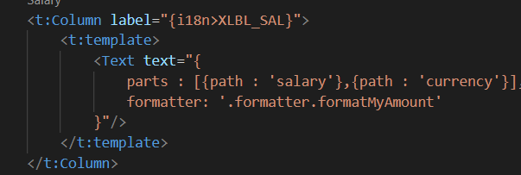
How to create formatter continue….
When we there are two fields bind in one
for e.g:
Here we have to bind in a little different format and the format will be
“{ parts : [{path : ‘salary’},{path : ‘currency’}] , formatter : 'formatter.formatterfunction’ }”

Slide 9

Hand-on: Formatter
Create a formatter to format the employee name in table to uppercase .
Format the Salary and currency of the employee in the table using formatter.
By following the steps discussed in the previous slides.
Code link:
Main.view.xml
Main.controller.js
lifeSaver.js

Slide 10

End of Day 8

Slide 11

Questions

Slide 12

Anubhav Oberoy

Slide 13


We’re committed to empower you to be
Most Desirable Resource
through powerful training solutions.
We build the workforce of the future.
250+
Corporate Clients
30,000+
Learners Trained
25000+
Learners Placed
FREE WEBINARS
Sign up for free webinars with industry experts every fortnight!
Enroll Now!
Contact us today!
https://anubhavtrainings.com/

Slide 14




More from AnubhavTrainings.com

Slide 15
Title
Content

